Slide 1


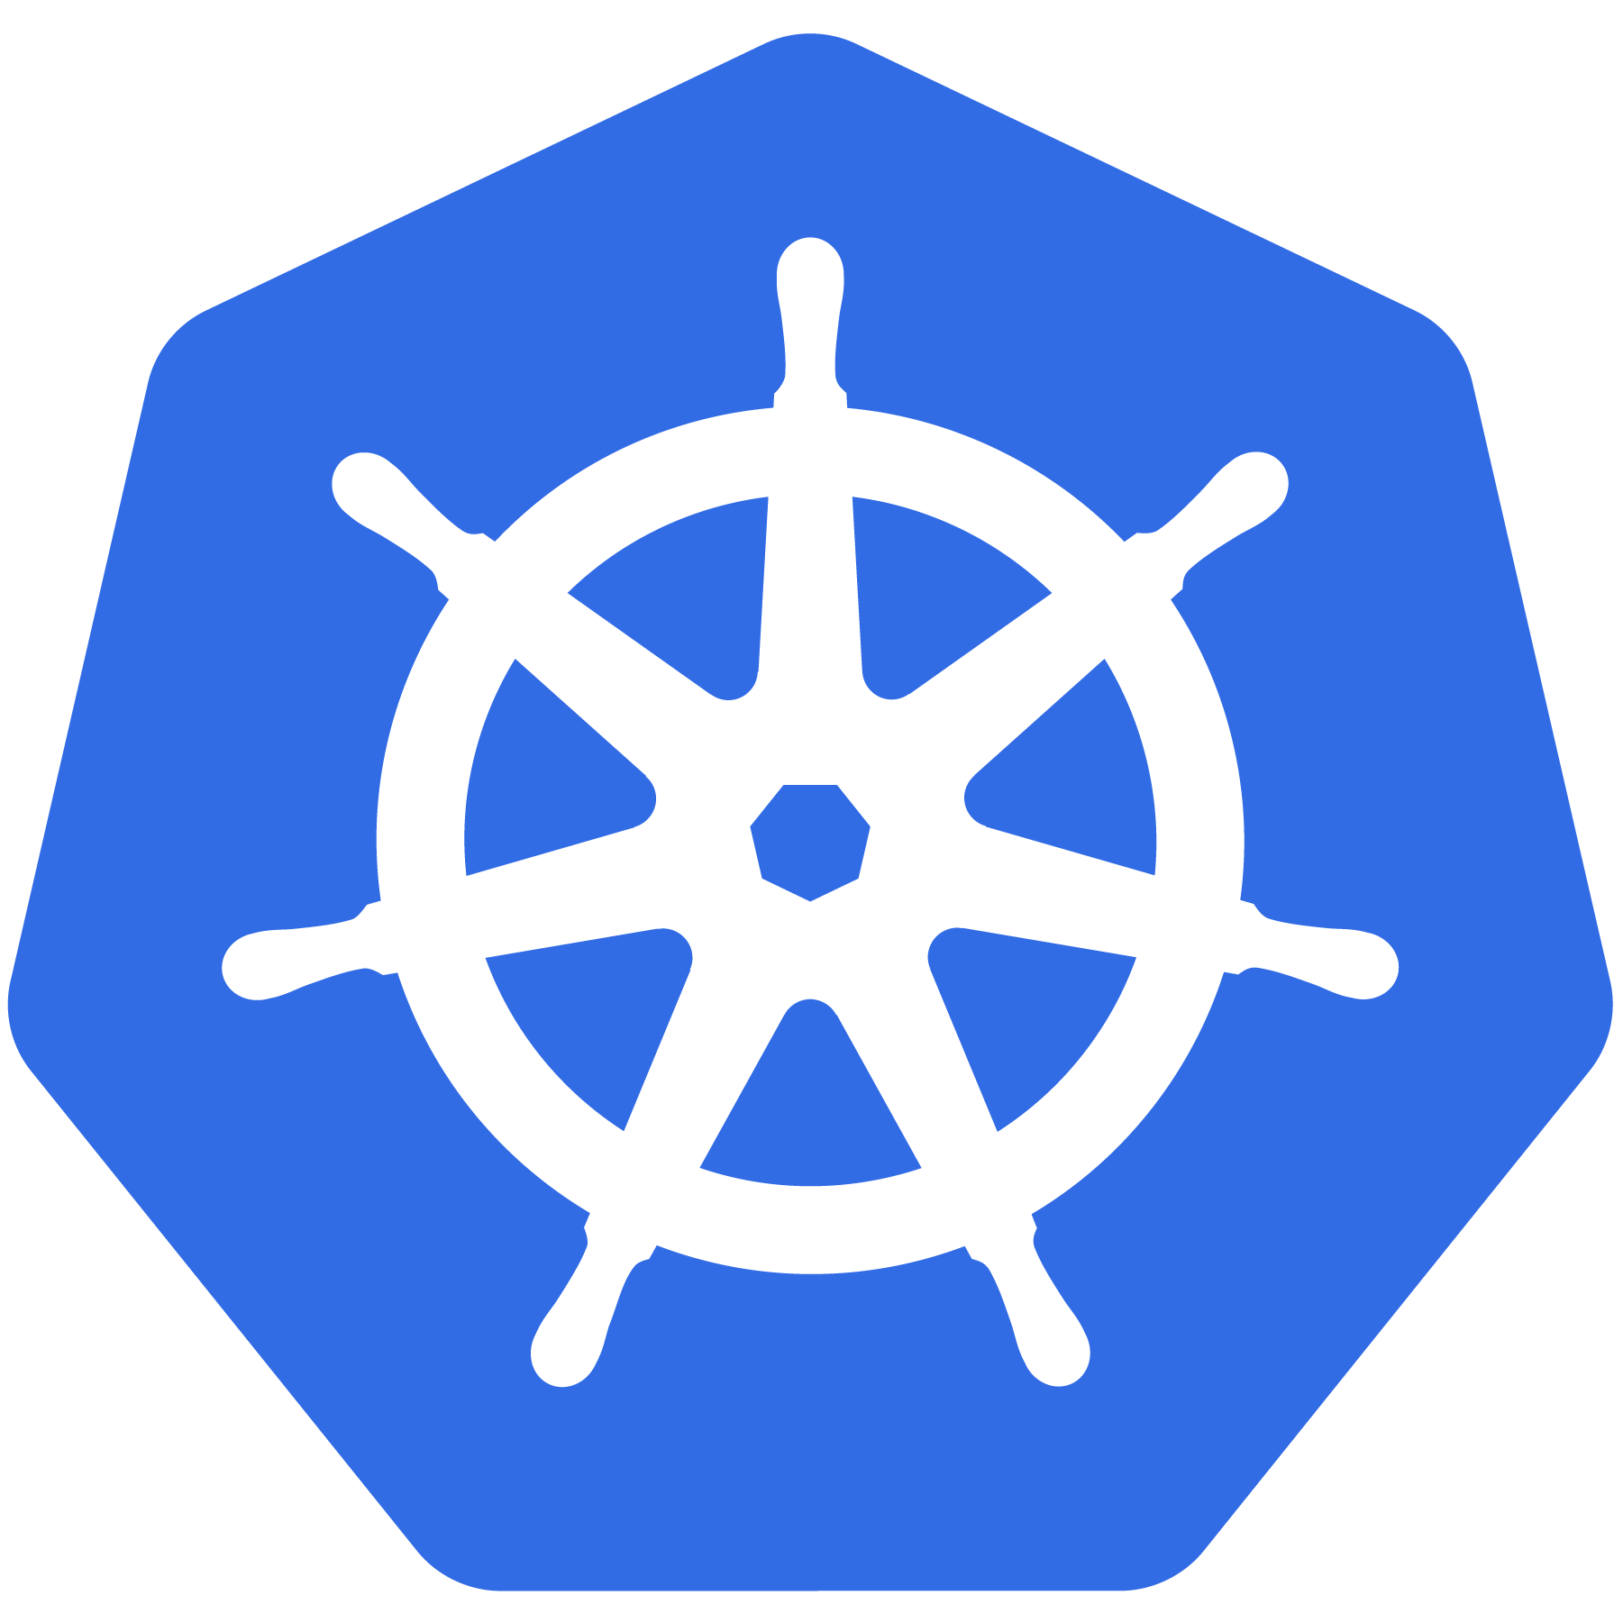

Kubernetes
INTRODUCTION - TRAINING

Slide 2

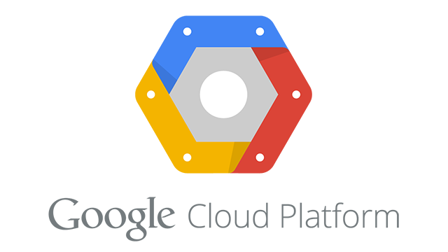

What is Kubernetes?
A Production-Grade Container Orchestration System Google-grown, based on Borg and Omega, systems that run inside of Google right now and are proven to work at Google for over 10 years.
Google spawns billions of containers per week with these systems.
Created by three Google employees initially during the summer of 2014; grew exponentially and became the first project to get donated to the CNCF.
Hit the first production-grade version v1.0.1 in July 2015. Has continually released a new minor version every three months since v1.2.0 in March 2016. Lately v1.13.0 was released in December 2018.
Copyright © 2020 Accenture. All rights reserved.
2

Slide 3
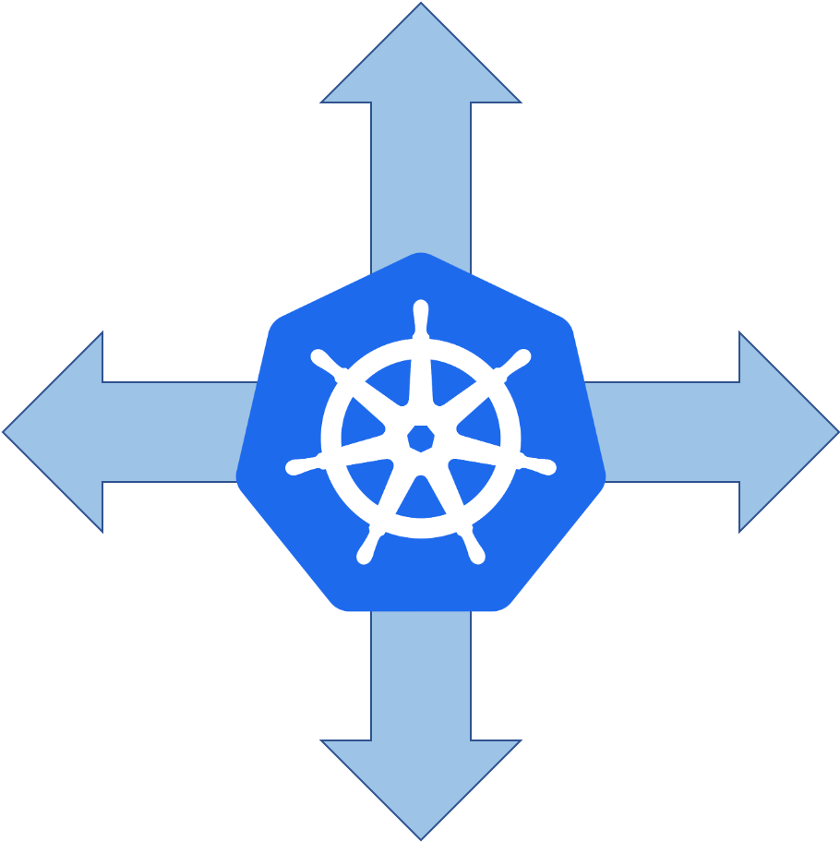
Decouples Infrastructure and Scaling
All services within Kubernetes are natively Load Balanced.
Can scale up and down dynamically.
Used both to enable self-healing and seamless upgrading or rollback of applications.
Copyright © 2020 Accenture. All rights reserved.
3

Slide 4
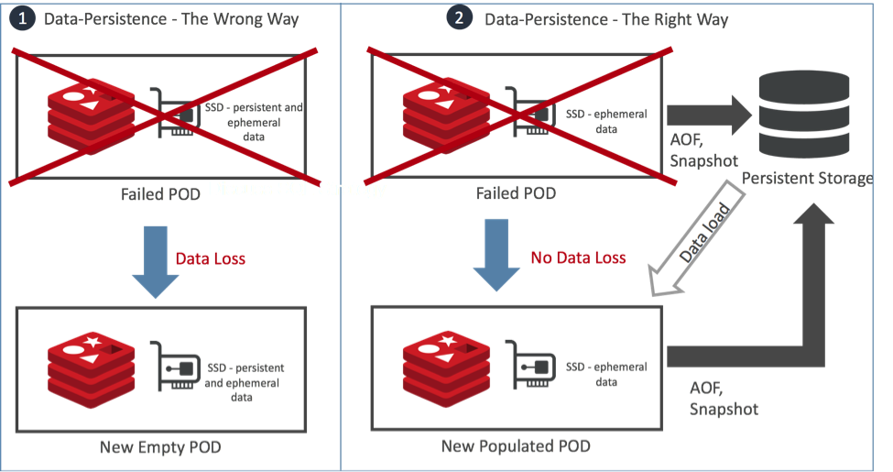
Self Healing
Kubernetes will ALWAYS try and steer the cluster to its desired state.
Example :
Me: “I want 3 healthy instances of redis to always be running.”
Kubernetes: “Okay, I’ll ensure there are always 3 instances up and running.”
Kubernetes: “Oh look, one has died. I’m going to attempt to spin up a new one.”
Copyright © 2020 Accenture. All rights reserved.
4

Slide 5

KEY
CONCEPTS
Copyright © 2020 Accenture. All rights reserved.
5

Slide 6
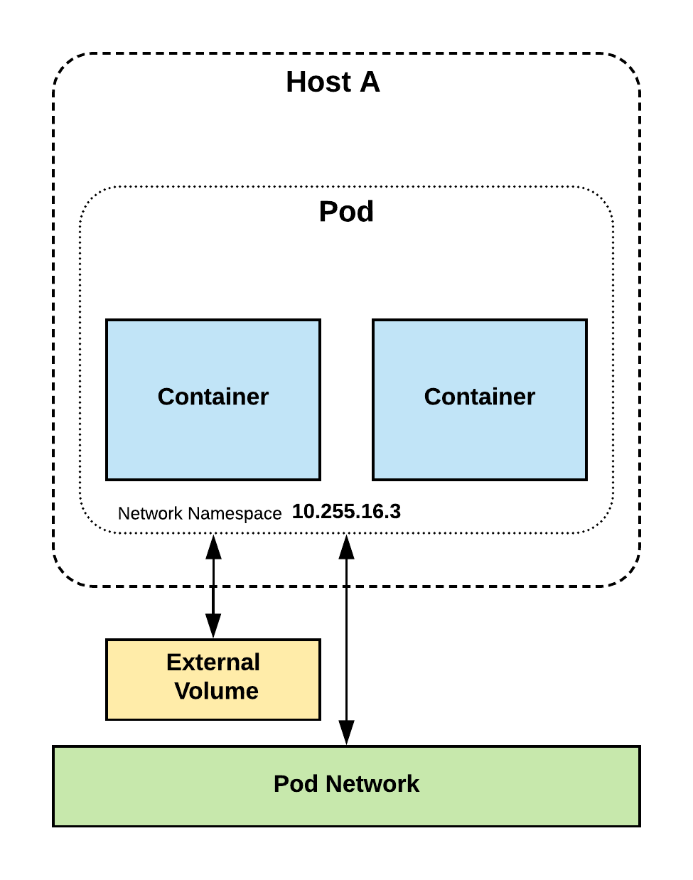
Pods
Atomic unit or smallest “unit of work” of Kubernetes.
Pods are one or MORE containers that share volumes and namespace.
They are also ephemeral!
Copyright © 2020 Accenture. All rights reserved.
6

Slide 7
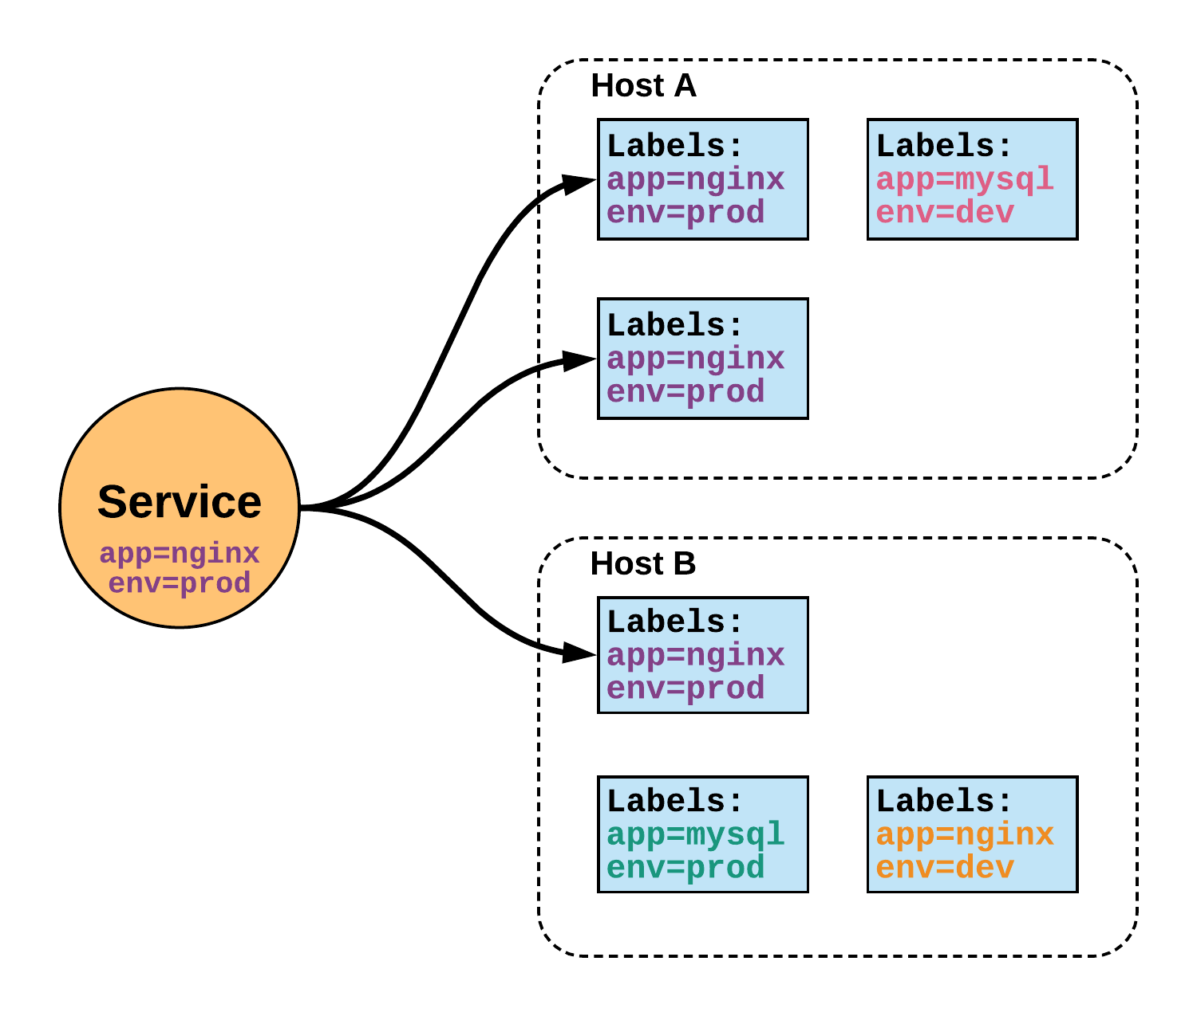
Services
Unified method of accessing the exposed workloads of Pods.
Durable resource – static cluster IP
Durable resource - static namespaced DNS name
Copyright © 2020 Accenture. All rights reserved.
7

Slide 8
ARCHITECTURE
OVERVIEW
Copyright © 2020 Accenture. All rights reserved.
8

Slide 9
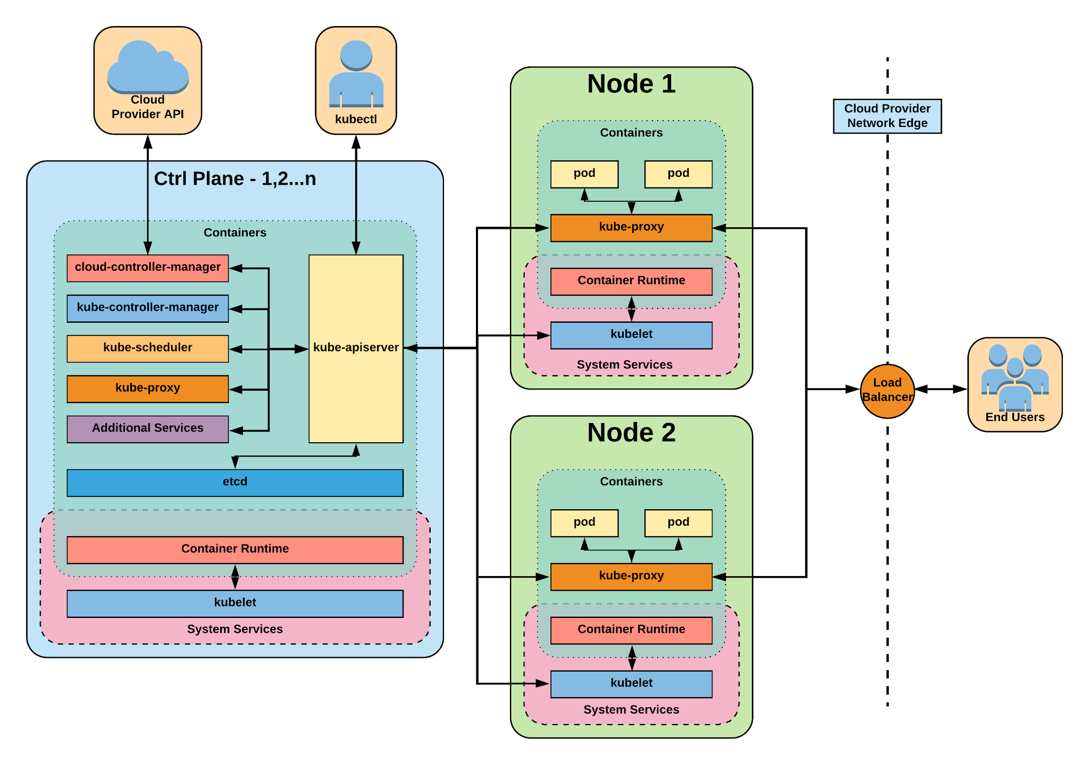
Architecture
Copyright © 2020 Accenture. All rights reserved.
9

Slide 10
CONTROL PLANE COMPONENTS
Copyright © 2020 Accenture. All rights reserved.
10

Slide 11

Control Plane Components
kube-apiserver
etcd
kube-controller-manager
kube-scheduler
cloud-controller-manager
Copyright © 2020 Accenture. All rights reserved.
11

Slide 12
kube-apiserver
Provides a forward facing REST interface into the kubernetes control plane and datastore.
All clients and other applications interact with kubernetes strictly through the API Server.
Acts as the gatekeeper to the cluster by handling authentication and authorization, request validation, mutation, and admission control in addition to being the front-end to the backing datastore.
Copyright © 2020 Accenture. All rights reserved.
12

Slide 13

etcd
etcd acts as the cluster datastore.
Purpose in relation to Kubernetes is to provide a strong, consistent and highly available key-value store for persisting cluster state.
Stores objects and config information.
Copyright © 2020 Accenture. All rights reserved.
13

Slide 14
kube-controller-manager
Monitors the cluster state via the apiserver and steers the cluster towards the desired state.
Node Controller: Responsible for noticing and responding when nodes go down.
Replication Controller: Responsible for maintaining the correct number of pods for every replication controller object in the system.
Endpoints Controller: Populates the Endpoints object (that is, joins Services & Pods).
Service Account & Token Controllers: Create default accounts and API access tokens for new namespaces.
Copyright © 2020 Accenture. All rights reserved.
14

Slide 15
kube-scheduler
Component on the master that watches newly created pods that have no node assigned and selects a node for them to run on.
Factors considered for scheduling decisions include individual and collective resource requirements, hardware/software/policy constraints, affinity and anti-affinity specifications, data locality, inter-workload interference and deadlines.
Copyright © 2020 Accenture. All rights reserved.
15

Slide 16
cloud-controller-manager
Node Controller: For checking the cloud provider to determine if a node has been deleted in the cloud after it stops responding
Route Controller: For setting up routes in the underlying cloud infrastructure
Service Controller: For creating, updating and deleting cloud provider load balancers
Volume Controller: For creating, attaching, and mounting volumes, and interacting with the cloud provider to orchestrate volumes
Copyright © 2020 Accenture. All rights reserved.
16

Slide 17
NODE
COMPONENTS
Copyright © 2020 Accenture. All rights reserved.
17

Slide 18
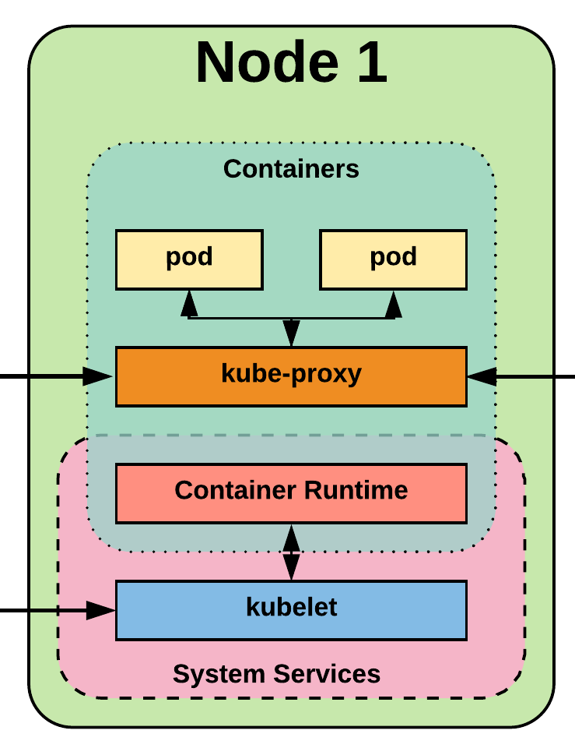
Node Components
kubelet
kube-proxy
Container Runtime Engine
Copyright © 2020 Accenture. All rights reserved.
18

Slide 19
kubelet
An agent that runs on each node in the cluster. It makes sure that containers are running in a pod.
The kubelet takes a set of PodSpecs that are provided through various mechanisms and ensures that the containers described in those PodSpecs are running and healthy.
Copyright © 2020 Accenture. All rights reserved.
19

Slide 20
kube-proxy
Manages the network rules on each node.
Performs connection forwarding or load balancing for Kubernetes cluster services.
Copyright © 2020 Accenture. All rights reserved.
20

Slide 21
Container Runtime Engine
A container runtime is a CRI (Container Runtime Interface) compatible application that executes and manages containers.
Containerd (docker)
Cri-o
Rkt
Kata (formerly clear and hyper)
Virtlet (VM CRI compatible runtime)
Copyright © 2020 Accenture. All rights reserved.
21

Slide 22
Architecture
Copyright © 2020 Accenture. All rights reserved.
22

Slide 23
NETWORKING
Copyright © 2020 Accenture. All rights reserved.
23

Slide 24
Fundamental Networking Rules
All containers within a pod can communicate with each other unimpeded.
All Pods can communicate with all other Pods without NAT.
All nodes can communicate with all Pods (and vice-versa) without NAT.
The IP that a Pod sees itself as is the same IP that others see it as.
Copyright © 2020 Accenture. All rights reserved.
24

Slide 25
Fundamentals Applied
Container-to-Container
Containers within a pod exist within the same network namespace and share an IP.
Enables intrapod communication over localhost.
Pod-to-Pod
Allocated cluster unique IP for the duration of its life cycle.
Pods themselves are fundamentally ephemeral.
Pod-to-Service
managed by kube-proxy and given a persistent cluster unique IP
exists beyond a Pod’s lifecycle.
External-to-Service
Handled by kube-proxy.
Works in cooperation with a cloud provider or other external entity (load balancer).
Copyright © 2020 Accenture. All rights reserved.
25

Slide 26
CORE OBJECT & API
Copyright © 2020 Accenture. All rights reserved.
26

Slide 27
Namespaces
Namespaces are a logical cluster or environment, and are the primary method of partitioning a cluster or scoping access
apiVersion: v1
kind: Namespace
metadata:
name: prod
labels:
app: WebApp
$ kubectl get ns --show-labels
NAME STATUS AGE LABELS
default Active 11h <none>
kube-public Active 11h <none>
kube-system Active 11h <none>
prod Active 6s app=MyBigWebApp
Copyright © 2020 Accenture. All rights reserved.
27

Slide 28
Pod Examples
Namespaces are a logical cluster or environment, and are the primary method of partitioning a cluster or scoping access
name - The name of the container
image - The container image
ports - array of ports to expose. Can be granted a friendly name and protocol may be specified
env - array of environment variables
command - Entrypoint array (equiv to Docker ENTRYPOINT)
args - Arguments to pass to the command (equiv to Docker CMD)
apiVersion: v1
kind: Pod
metadata:
name: pod-example
spec:
containers:
- name: nginx
image: nginx:stable-alpine
ports:
- containerPort: 80
apiVersion: v1
kind: Pod
metadata:
name: pod-example
labels: app: nginx
spec:
template:
metadata:
labels: app: nginx
spec:
containers:
- name: nginx
image: nginx
name: nginx
image: nginx:stable-alpine
ports:
- containerPort: 80
name: http
protocol: TCP
env:
- name: MYVAR
value: isAwesome
command: [“/bin/sh”, “-c”]
args: [“echo ${MYVAR}”]
Copyright © 2020 Accenture. All rights reserved.
28

Slide 29
Pod Template
Workload Controllers manage instances of Pods based off a provided template.
Pod Templates are Pod specs with limited metadata.
Controllers use Pod Templates to make actual pods.
apiVersion: v1
kind: Pod
metadata:
name: pod-example
labels: app: nginx
spec:
template:
metadata:
labels: app: nginx
spec:
containers:
- name: nginx
image: nginx
Copyright © 2020 Accenture. All rights reserved.
29

Slide 30
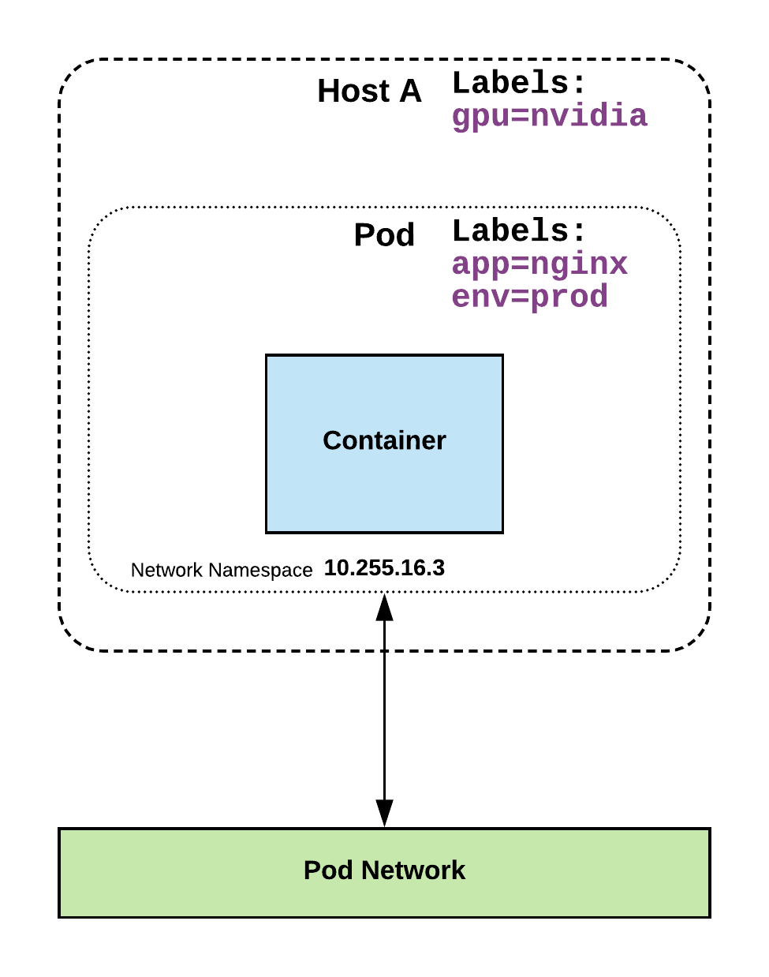
Labels
key-value pairs that are used to identify, describe and group together related sets of objects or resources.
NOT characteristic of uniqueness.
Have a strict syntax with a slightly limited character set*.
* https://kubernetes.io/docs/concepts/overview/working-with-objects/labels/#syntax-and-character-set
Copyright © 2020 Accenture. All rights reserved.
30

Slide 31
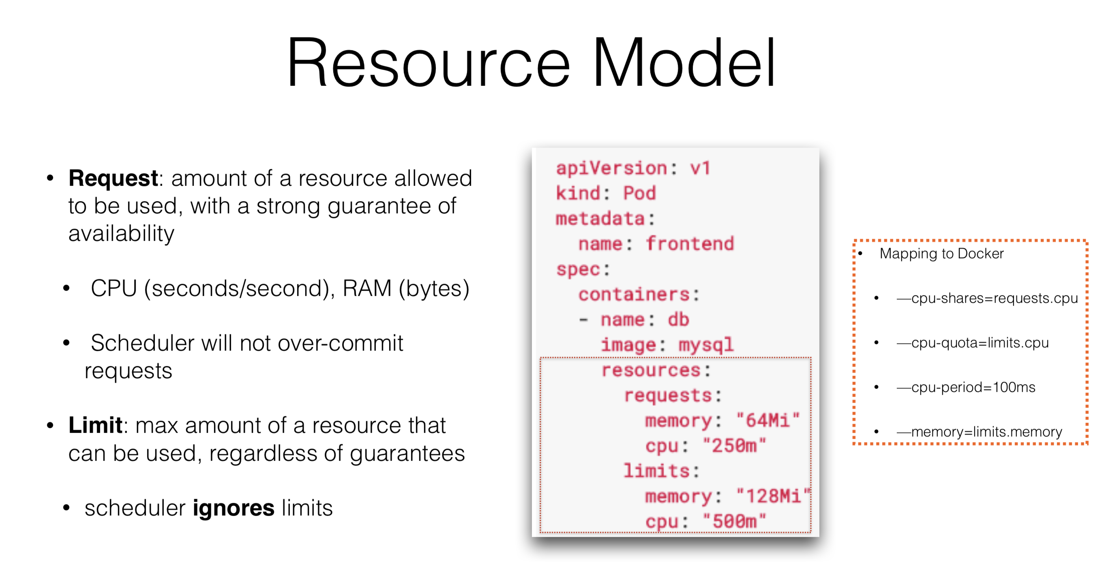
Copyright © 2020 Accenture. All rights reserved.
31

Slide 32
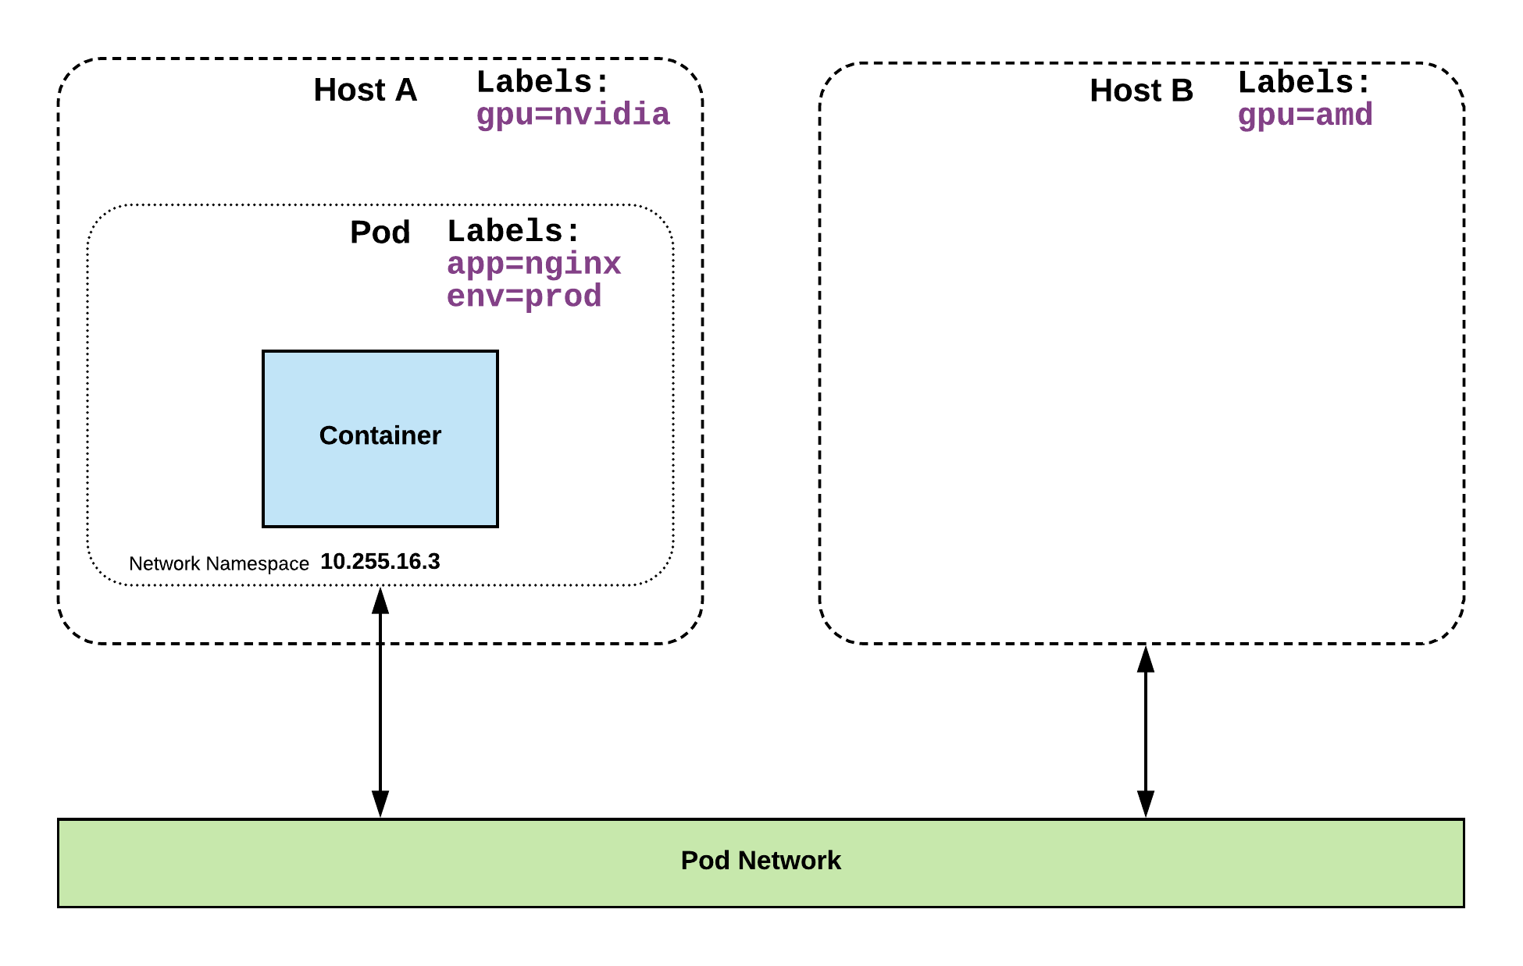
Selectors
Selectors use labels to filter or select objects, and are used throughout Kubernetes.
apiVersion: v1
kind: Pod
metadata:
name: pod-label-example
labels: app: nginx env: prod
spec:
containers:
- name: nginx
image: nginx:stable-alpine
ports:
- containerPort: 80 nodeSelector:
gpu: nvidia
Copyright © 2020 Accenture. All rights reserved.
32

Slide 33
Selector Types
Equality based selectors allow for simple filtering (=,==, or !=).
Set-based selectors are supported on a limited subset of objects. However, they provide a method of filtering on a set of values, and supports multiple operators including: in, notin, and exist.
selector:
matchLabels:
gpu: nvidia
selector:
matchExpressions:
- key: gpu
operator: in
values: [“nvidia”]
Copyright © 2020 Accenture. All rights reserved.
33

Slide 34
Services
Unified method of accessing the exposed workloads of Pods.
Durable resource (unlike Pods)
static cluster-unique IP
static namespaced DNS name
Target Pods using equality based selectors.
Uses kube-proxy to provide simple load-balancing.
kube-proxy acts as a daemon that creates local entries in the host’s iptables for every service.
There are 4 major service types:
ClusterIP (default)
NodePort
LoadBalancer
ExternalName
<service name>.<namespace>.svc.cluster.local
Copyright © 2020 Accenture. All rights reserved.
34

Slide 35
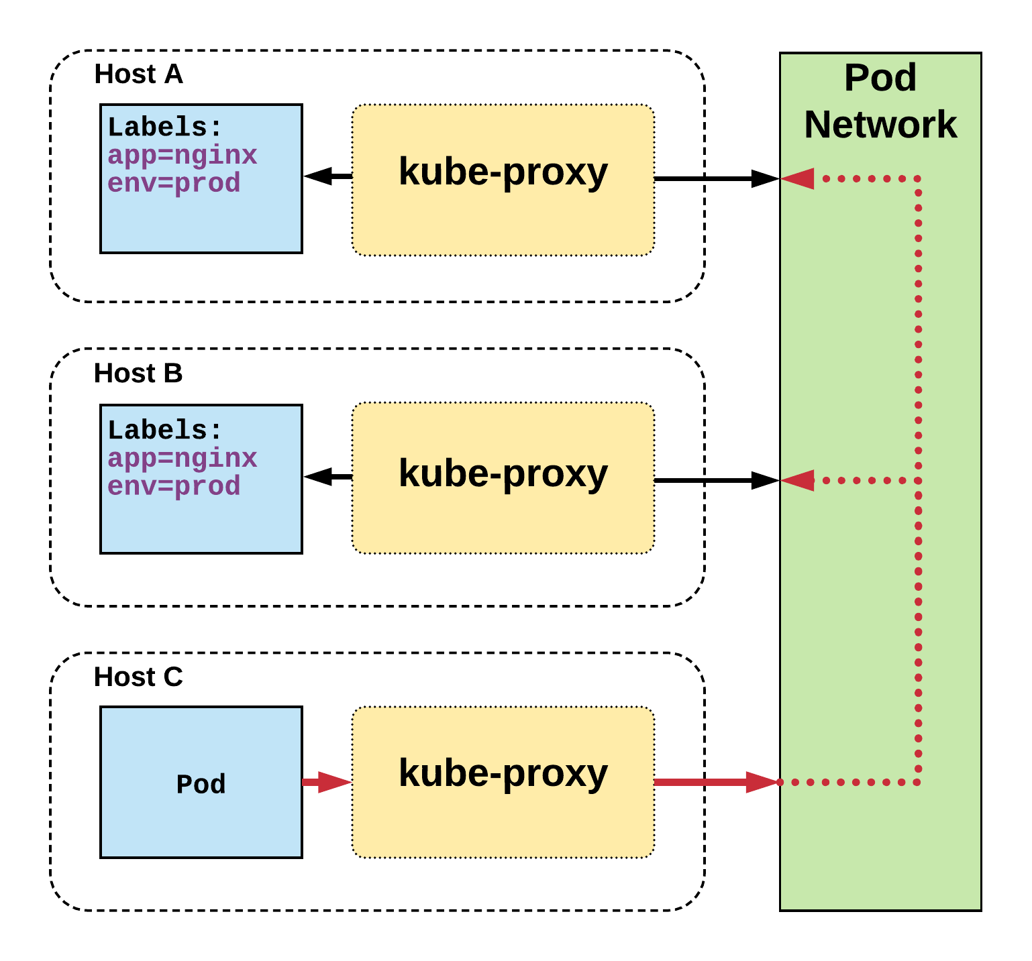
ClusterIP Service
ClusterIP services exposes a service on a strictly cluster internal virtual IP
Name: example-prod
Selector: app=nginx,env=prod
Type: ClusterIP
IP: 10.96.28.176
Port: <unset> 80/TCP
TargetPort: 80/TCP
Endpoints: 10.255.16.3:80, 10.255.16.4:80
apiVersion: v1
kind: Service
metadata:
name: example-prod
spec:
selector:
app: nginx
env: prod
ports:
- protocol: TCP
port: 80
targetPort: 80
/ # nslookup example-prod.default.svc.cluster.local
Name: example-prod.default.svc.cluster.local
Address 1: 10.96.28.176 example-prod.default.svc.cluster.local
Copyright © 2020 Accenture. All rights reserved.
35

Slide 36
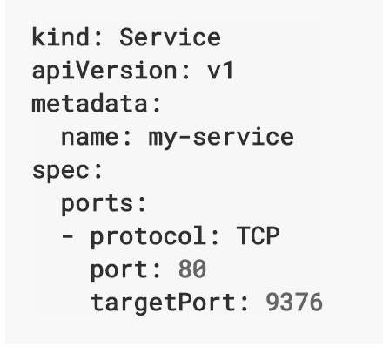
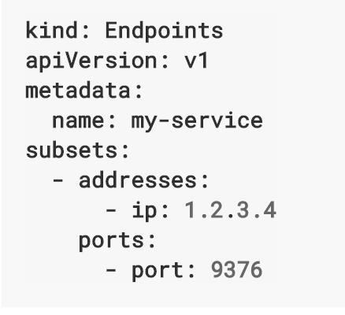
ClusterIP Service Without Selector
Copyright © 2020 Accenture. All rights reserved.
36

Slide 37
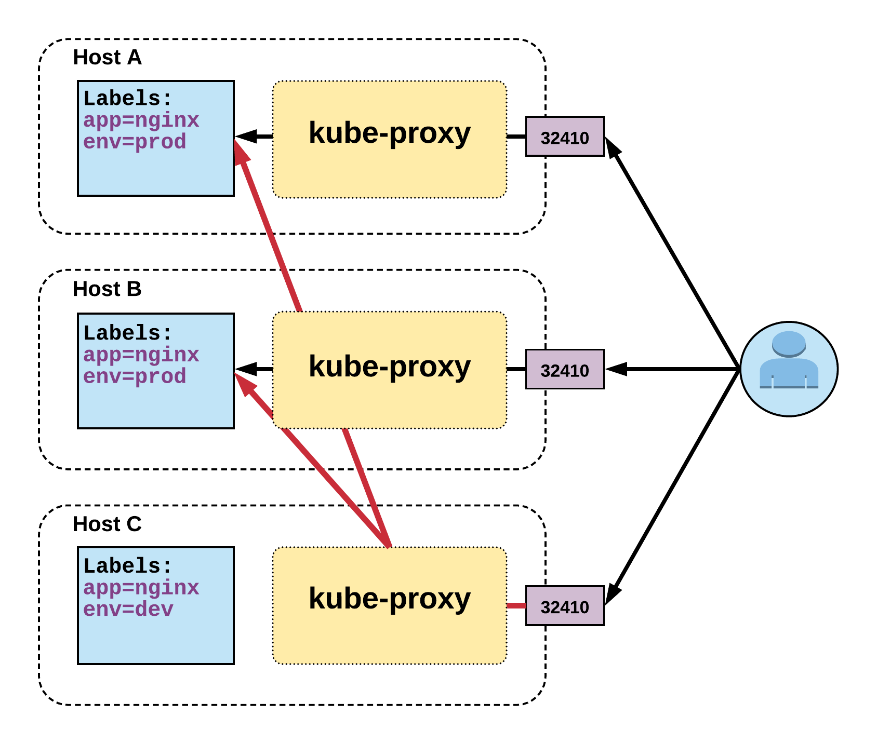
NodePort Service
apiVersion: v1
kind: Service
metadata:
name: example-prod
spec:
type: NodePort
selector:
app: nginx
env: prod
ports:
- nodePort: 32410
protocol: TCP
port: 80
targetPort: 80
NodePort services extend the ClusterIP service.
Exposes a port on every node’s IP.
Port can either be statically defined, or dynamically taken from a range between 30000-32767.
Name: example-prod
Selector: app=nginx,env=prod
Type: NodePort
IP: 10.96.28.176
Port: <unset> 80/TCP
TargetPort: 80/TCP
NodePort: <unset> 32410/TCP
Endpoints: 10.255.16.3:80, 10.255.16.4:80
Copyright © 2020 Accenture. All rights reserved.
37

Slide 38
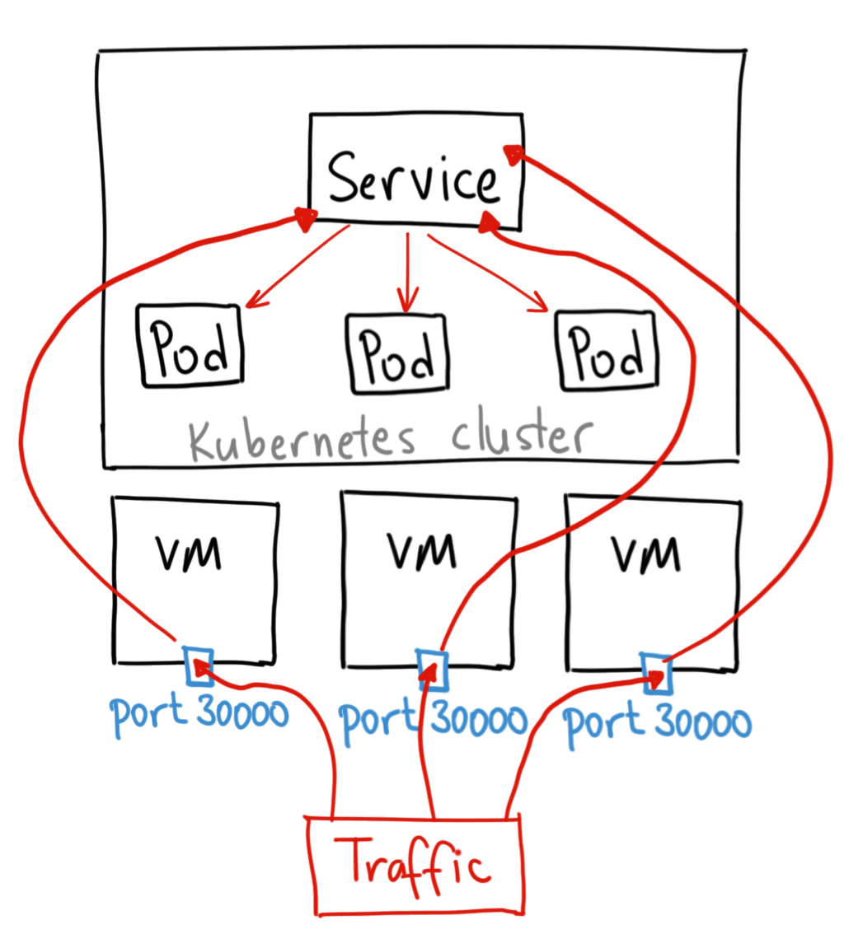
LoadBalancer Service
LoadBalancer services extend NodePort.
Works in conjunction with an external system to map a cluster external IP to the exposed service.
apiVersion: v1
kind: Service
metadata:
name: example-prod
spec:
type: LoadBalancer
selector:
app: nginx
env: prod
ports:
protocol: TCP
port: 80
targetPort: 80
Copyright © 2020 Accenture. All rights reserved.
38

Slide 39
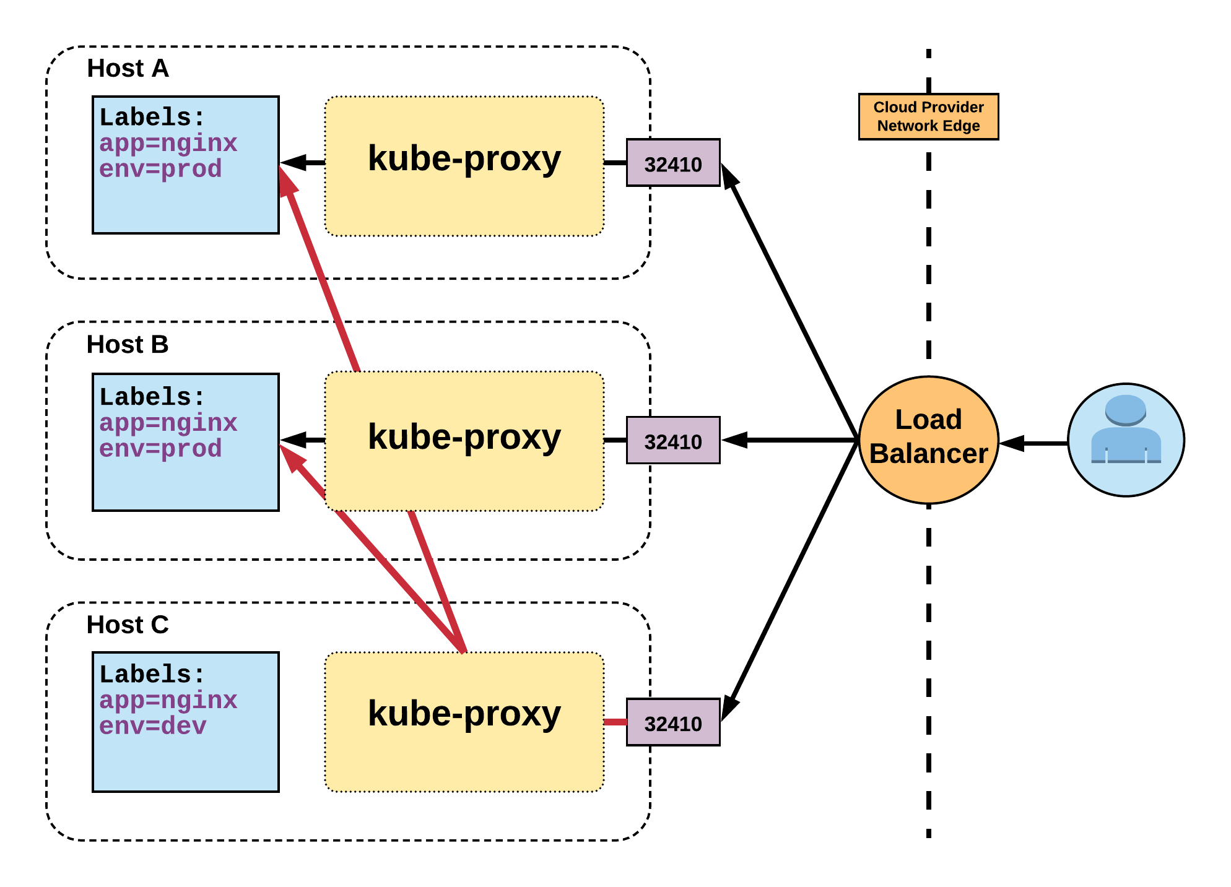
LoadBalancer Service
Name: example-prod
Selector: app=nginx,env=prod
Type: LoadBalancer
IP: 10.96.28.176
LoadBalancer Ingress: 172.17.18.43
Port: <unset> 80/TCP
TargetPort: 80/TCP
NodePort: <unset> 32410/TCP
Endpoints: 10.255.16.3:80, 10.255.16.4:80

Slide 40
ExternalName Service
ExternalName is used to reference endpoints OUTSIDE the cluster.
Creates an internal CNAME DNS entry that aliases another.
apiVersion: v1
kind: Service
metadata:
name: example-prod
spec:
type: ExternalName
spec:
externalName: example.com

Slide 41
Ingress – Name Based Routing
An API object that manages external access to the services in a cluster
Provides load balancing, SSL termination and name/path-based virtual hosting
Gives services externally-reachable URLs
apiVersion: extensions/v1beta1
kind: Ingress
metadata:
name: name-virtual-host-ingress
spec:
rules:
- host: first.bar.com
http:
paths:
- backend:
serviceName: service1
servicePort: 80
- host: second.foo.com
http:
paths:
- backend:
serviceName: service2
servicePort: 80
- http:
paths:
- backend:
serviceName: service3
servicePort: 80

Slide 42
QUESTION ?
Copyright © 2020 Accenture. All rights reserved.
42

